Slide 1
Introduction to
IT Project Management
Dr. Elshaimaa Ramadan
Teaching Assistants:
Rana Alaaeldin
Salwa Megahed
Sherrie Kareem
Tutorial 4
Spring Semester 2019
IT Project Management-Tutorial 4

Slide 2
STRATEGIC PLANNING AND PROJECT SELECTION
IT Project Management-Tutorial 4

Slide 3

There are usually more projects than available time and resources to implement them
Methods for selecting projects include:
  focusing on broad organizational needs
  categorizing information technology projects
  performing net present value or other financial analyses
  using a weighted scoring model
  implementing a balanced scorecard
Information Technology Project Management, Seventh Edition

Slide 4
Financial considerations are often an important consideration in selecting projects
Three primary methods for determining the projected financial value of projects:
  Net present value (NPV) analysis
  Return on investment (ROI)
  Payback analysis
Information Technology Project Management, Seventh Edition

Slide 5
Net present value (NPV) analysis is a method of calculating the expected net monetary gain or loss from a project by discounting all expected future cash inflows and outflows to the present point in time
Projects with a positive NPV should be considered if financial value is a key criterion
The higher the NPV, the better
Information Technology Project Management, Seventh Edition

Slide 6

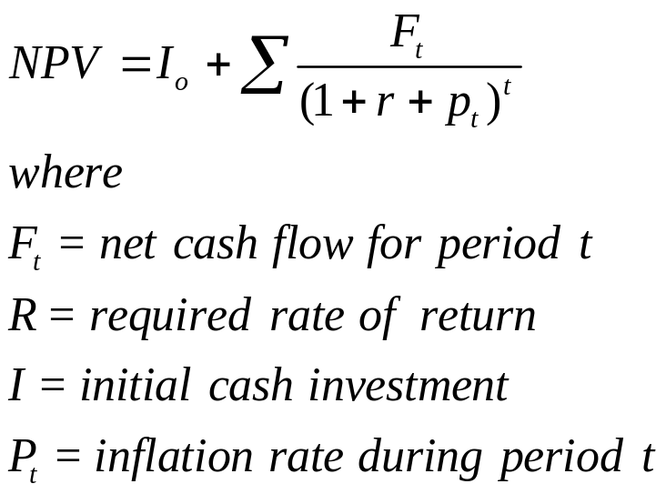
Projects the change in the firm’s stock value if a project is undertaken.
Higher NPV values are better!
3/3/2018

Slide 7
Exercise using MS Project !!
IT Project Management-Tutorial 3

